Slide 1
The Ministeriality of the Brother in the Church
Friar Oton da Silva Araújo Júnior, ofm
Suzano/SP, 23 February 2018.

Slide 2
p. 1
Post-conciliar
Period
Pope Francis
Insufficient Formation
Limited missionary outreach

Slide 3
Ministerial Ecclesiology
Religious Brother

Slide 4
I. Lay Religious in Conciliar Documents
a) Lumen Gentium: the Church, people of God
Baptism
Common Priesthood
Call to Holiness (Chapter 5).
Evangelical councils = chapter 5 (on holiness) and not chapter 6 (on Religious).
Be signs = To be a living remembrance of the brotherhood of Jesus.
p. 2

Slide 5
Insufficient explanation = LG 43
RELIGIOUS (?)
LAITY
CLÉRICS

Slide 6
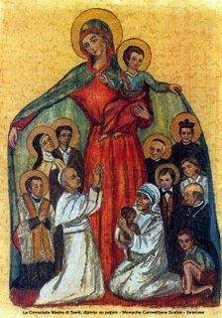
RELIGIOUS BROTHER = a new way of being Church, more fraternal, more participatory, a Church-communion that not only has the face of Peter, but the features of Mary.

Slide 7
b) Decree Perfectae Caritatis
Call to return "to the sources of the whole Christian life and to the genuine inspiration of the Institutes, but also their adaptation to the new conditions of the times" (PC 2).
"Where the encounter with these sources and with the original inspiration was partial or weak, the fraternal life took risks and also had a certain diminution of vigor" (The Fraternal Life in Community, n.1).

Slide 8
PC 10 = "The lay religious life, both of men and women, constitutes in itself a complete state of the profession of the evangelical counsels".
≠ Incomplete
Complete state ≠ half way
Great esteem for the Lay religious life, "so useful it is, to the pastoral mission of the Church in the education of youth, care of the sick and other ministries." = to be and to do.
PC = emphasis on disciplinary norms and not on theological problems of Religious Life.

Slide 9
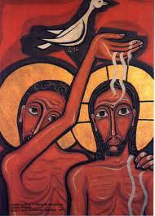
c) Synod on Consecrated Religious Life - Vita Consecrata.
Baptism = evangelical counsels
≠ Celibacy and virginity, renunciation of property, and obedience to a superior.

Slide 10
d) The Year of Religious Life p. 4
Communion
Gospel

Slide 11
p. 5
"The identity of the consecrated person depends on the spiritual maturation: it is the work of the Spirit that impels one to conform to Jesus Christ, according to that particular modality that is given by the original charism, mediation of the Gospel to the members of a certain institute"
(Fraternal Life in community, n. 36).

Slide 12
COMMUNION
Internal aspects of the Church
Secularity
culture, science, health, work, (All of you, 10, §5).

Slide 13
Integrating
Prayer.
Sacred.
Life.
Profane.

Slide 14
The prophetic-missionary dimension
p. 6
Persons with their own fragility and limitations.
Seduced by the Lord.
In this people of prophets, the mission of the religious Brother, as an individual and as a community, is inserted: to live and proclaim the prophecy of fraternity, in civil society and in the Church. (FERRE, 2015).
Not as lonely wolves.
Value of Community

Slide 15
p. 7
"To renew the prophecy is to renew our commitment not to wait for an ideal world, an ideal community, an ideal discipleship to live or to evangelize, but to create the conditions so that every discouraged person can meet Jesus. You do not love situations or ideal communities, you love people "(16.01.18).
Mission like this is not a task, but an identity. I am a mission on this earth and for this I am in this world.

Slide 16
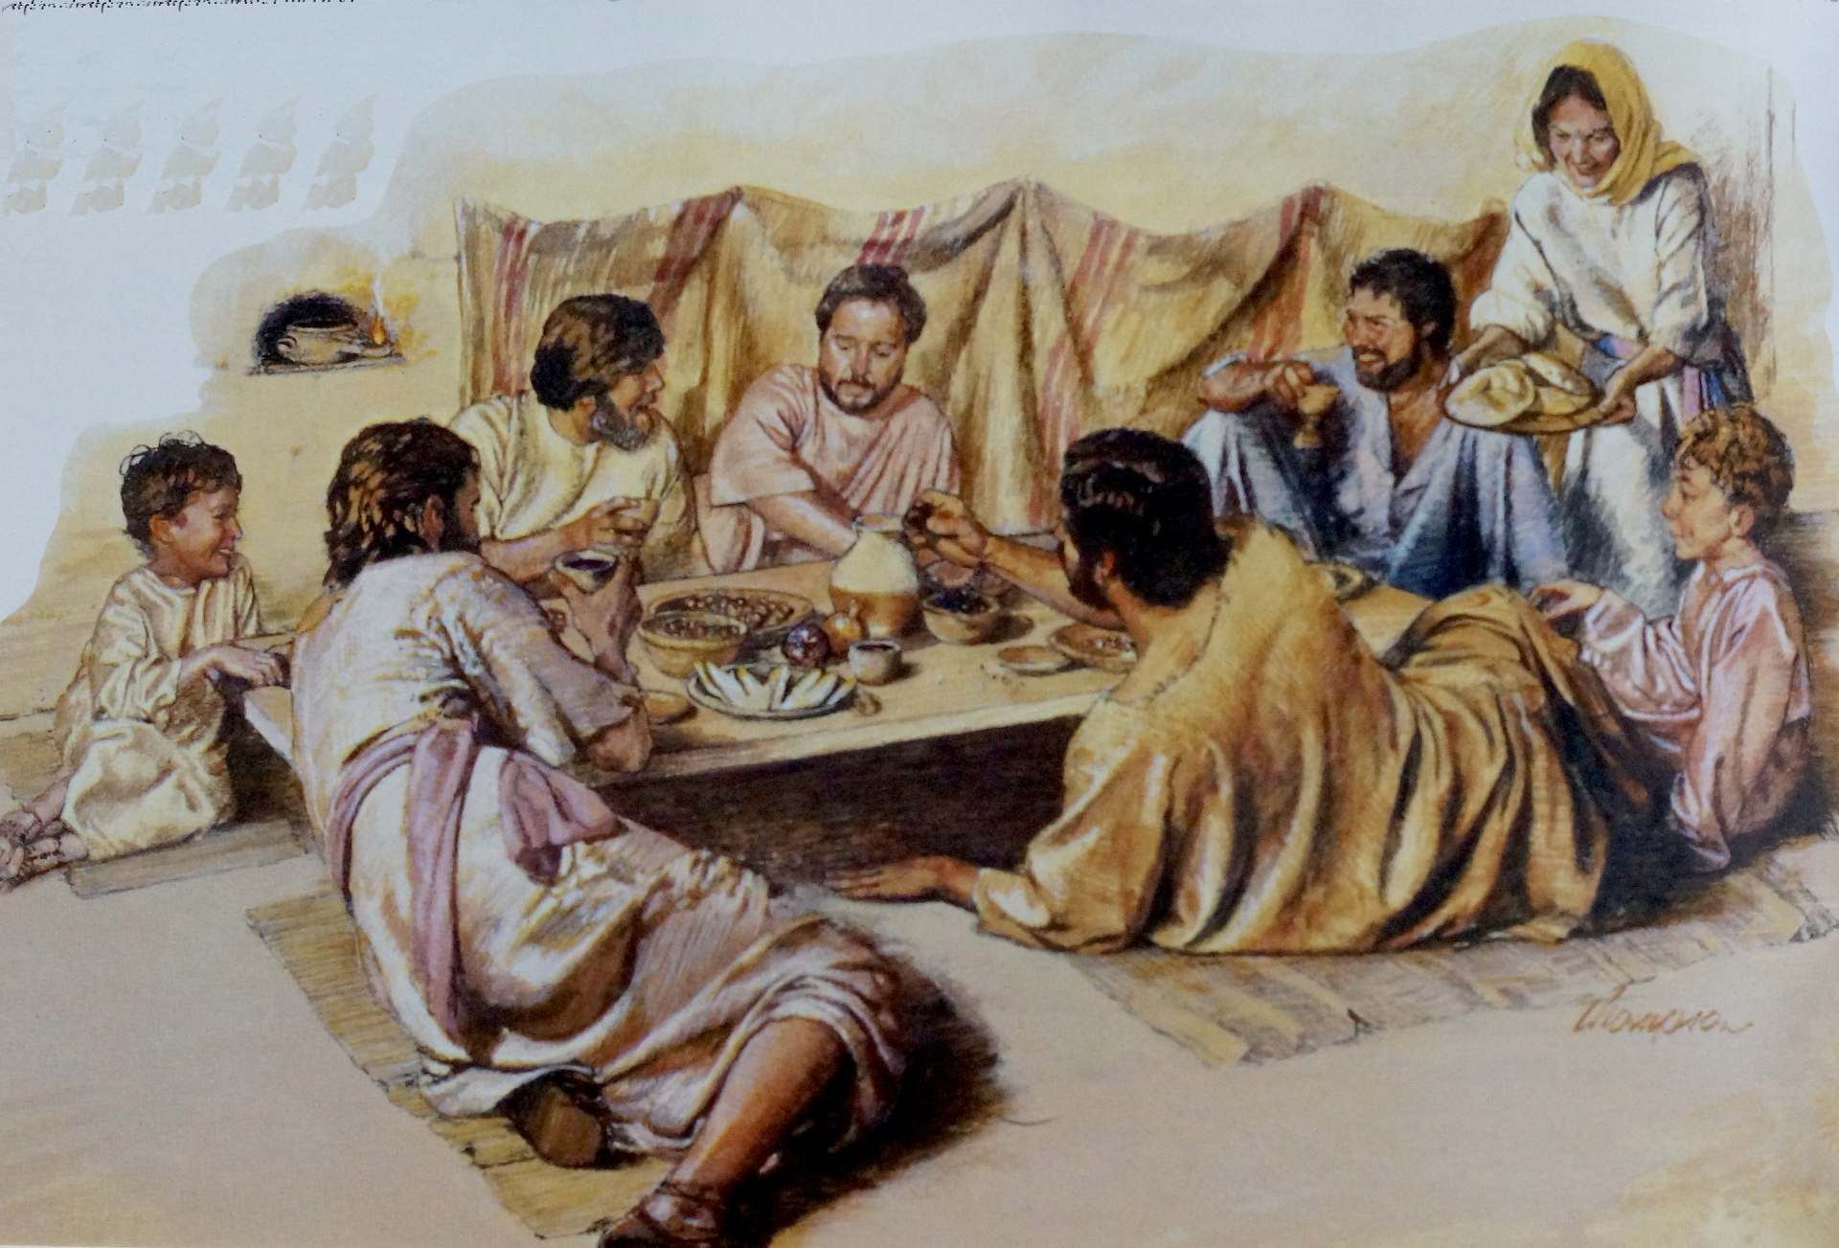
III. THE THEOLOGY OF BROTHER JESUS p. 8
AT: 'ah, adelphos = Election of God. 'Next'.
NT: 'brother': biological and spiritual sense.
'Next’ – close by.
Fraternity, diversity.

Slide 17
Paul and Matthew = fraterna metaphor
We are brothers.
Titus and Timothy
= metaphor of the house. Hierarchy.
p. 8-12

Slide 18
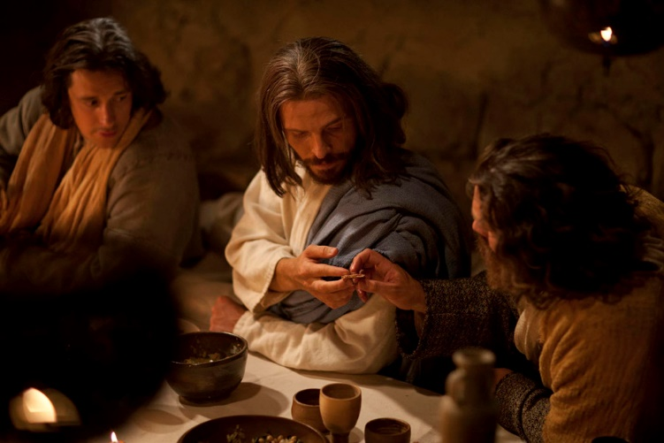
(p.11)
"If the Church does not live out fraternity and if she does not make fraternity a fundamental reason for its presence in the world, she is no longer the Church of Jesus."

Slide 19
IV. LAY BROTHERS TODAY:
BETWEEN CHALLENGES AND OPPORTUNITIES p. 12

Slide 20
p. 12
Individual / community
"The religious community is the place where the daily and patient passage from the ‘me’ to the ‘us’ takes place, from my commitment to the commitment entrusted to the community, from seeking ‘my things’ to seeking for ‘the things of Christ”
(Fraternal Life in Community, No. 39 ).

Slide 21
Community / Mission p. 13
“In some institutes, the tendency to focus more on mission than on community, as well as on privileging diversity rather than unity, profoundly influenced fraternal life in common, to the point of making it, at times, almost an option rather than an integral part of religious life.”
(Fraternal Life in Community, No. 59d).

Slide 22
Activism / Contemplation (p.13)
"In Religious Life, there are so many demands on the day to day that many do not have time to live as consecrated persons, which shows the contradiction: not having time to pray, to live with the people of our religious community, not having time to be with people 'out there', not having time to be a sign of the Kingdom."
(ARAÚJO JUNIOR , 2017, N. 77)

Slide 23
CHALLENGES TO THE LAY RELIGIOUS (p.14)
Secularity.
Clericalism
Professionalism.
Individualism,

Slide 24
neo-clericalismo: rubric + media
Formative itinerary;
A participação dos irmãos nos governos dos institutos
Participation of Brothers in the leadership services of their institutes/congregations.

Slide 25
p. 17
“Perhaps humanity today, more than before, has to take DNA test to discover, with difficulty, that we are Brothers, which refers to the dimension of care, concern, also in the small misunderstandings, typical of Brothers, but above all else, brothers.”

